Slide 1
User-friendly Ankle-foot orthotic (UF-AFO)
Group 11
Alessandra Hruschka
Gina Maliekal
Bryce Miller
Mentor: Dr. Kurt Thoroughman

Slide 2
Overview
Project Scope
Background
Existing Solutions
Need for Improvement
Design Specifications
Project Timeline
Team Organization

Slide 3
Project Scope
To develop a fail-safe ankle-foot orthotic design that addresses the existing problem of patients and/or caregivers improperly positioning the device during daily use and notifies the patient and/or caregiver if the device is worn improperly. The changes made to existing orthotic design will not alter the treatment intended by the device’s use. Rather, the changes will facilitate faster placement and removal of the orthotic with fewer opportunities for user error.

Slide 4
Irregular gait causes: Cerebral Palsy
Cerebral Palsy (CP), Polio, Spinal Cord Injury, Charcot-Marie-Tooth Syndrome and Strokes, Multiple Sclerosis
CP is “a non-progressive and non-hereditary disorder of motion and posture due to brain insult or injury occurring in the period of early brain growth” (M.S. Wong)
CP is one of the primary causes of irregular gait in children
1.4-2.3% of the US population has CP
As of 2005, roughly 53,000 AFOs were prescribed yearly for children with CP
(Figueiredo)

Slide 5
Normal and abnormal gait energy Expenditure
Ren 2007

Slide 6
Characterization: Dynamic foot pressure
Normal
Clubfoot

Slide 7
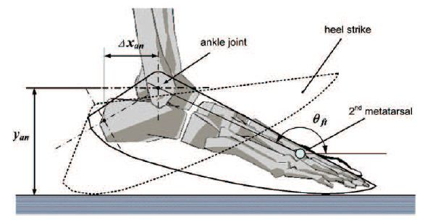
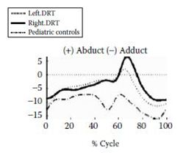
Characterization: 3d Foot and ankle motion analysis
Forefoot: Severe Flatfoot

Slide 8
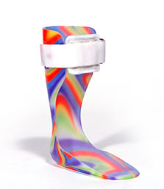
Ankle-foot orthotic (AFO) Goal
Improved gait control and energy efficiency
Greater mobility
Functional independence and participation in society
Orthotic & Prosthetic Design, Inc.

Slide 9
Types of AFOS
Flexible AFOs, Rigid AFOs, Tamarack Flexure Joint and Anti-Talus AFOs are the categories standardized by the ICRC (International Committee of the Red Cross) in 2006.
ICRC Manufacturing Guidelines 2006

Slide 10
Examples of AFOs
US Patent 7819832
US Patent Application 2003/0125653

Slide 11
Materials & Methods
Primary materials: polypropylene, polyethylene, and carbon fiber (older models made from leather and metal)
Methods:
Custom-made orthotics either by manual modeling from a positive or negative mold or computer-aided imaging
Off-the-shelf (prefabricated and sized)
US Patent Application 2009/0306801

Slide 12
Evaluation
The success of prior art in the field of AFO design has been quantitatively evaluated in three independent respects or combinations thereof:
body function
structure level
activity level
(Figueiredo 2008)

Slide 13
Need for improvement
AFOs are important for the treatment of CP but the user must comply with the instructions for effectiveness.
Appearance, fit and comfort are common reasons why a patient does not comply with instructions.
Interview with Dr. Neringa Juknis, Associate Professor of Neurology at Washington University School of Medicine in St. Louis
Unintentional user error is a reason for improper orthotic use (HKPU BME Summer Program 2011)

Slide 14
Design specifications
Lightweight (mass < 1 kg or 35 ounces)
Easy to both don and doff (<60 seconds)
Low maintenance (daily care duration < 60 seconds)
Inconspicuous (acceptable appearance to children users below the age of 18)
Low cost (cost to user < $500)
Produces intended biomechanical treatment and uses existing materials
No loss of durability
Sensor detecting improper use

Slide 15
Preliminary schedule

Slide 16
Current team organization
Alessandra Hruschka – AutoCAD Point Person, Progress Report Presenter, Biomechanics Researcher
Gina Maliekal – Preliminary Report Presenter, Field Research Point Person, Organizer
Bryce Miller – Final Reporter Presenter, Editor, Website Designer

Slide 17
references
US Patents:
US Patent Applications:
“Efficacy of Ankle-Foot Orthoses on Gait of Children with Cerebral Palsy: Systematic Review of Literature” Figueiredo et al. 2008. Pediatric Physical Therapy Journal. Volume 20 Issue 3.
Thanks to Dr. Neringa Juknis
M.S. Wong
ICRC Manufacturing Guidelines 2006

Slide 18
Questions?

