Slide 1
User Friendly
Fastening Device
(UF-FD)
Group 11
Bryce Miller, Alessandra Hruschka, Gina Maliekal
Notes:
UF-FD for AFO application

Slide 2
Review of Project

Slide 3
Design Need
AFOs – promoting proper ambulation
cerebral palsy patients
donning/doffing – introduction of user error
misalignment of orthotic and foot
deviation of treatment; exacerbation of deformity
rigid AFO – body, distal strap, proximal strap
proximal strap significant source of user error
patients and/or caretakers
Notes:
a significant application of AFOs – ankle foot orthotics – is correcting foot deformities and strengthening particular muscle groups in the leg and foot
cerebral palsy patients represent a significant portion of the patient population making up the target consumer group for the AFO-FD

Slide 4
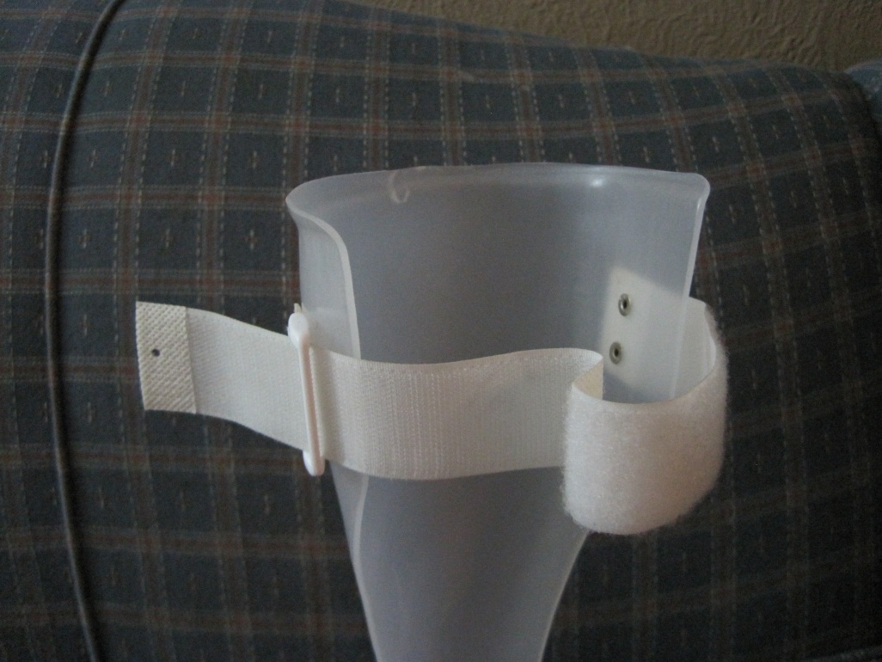
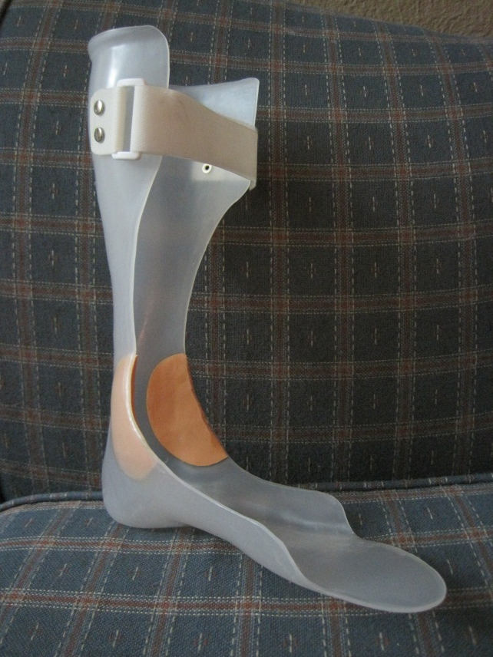
Current Solution
doubled over velcro strap

Slide 5
Design Requirements
compatible with anthropometric parameters of patient’s leg
minimum orthotic opening – 3 in.
lightweight
mass < 35 ounces
ease of donning/doffing
single-handed use
minimalistic instruction
product life
resistance to wear, corrosion, component failure
inconspicuous
requires actual input from children patients
low maintenance
no special care required
low cost
entire AFO <$500
compatible implementation with existing AFO manufacture

Slide 6
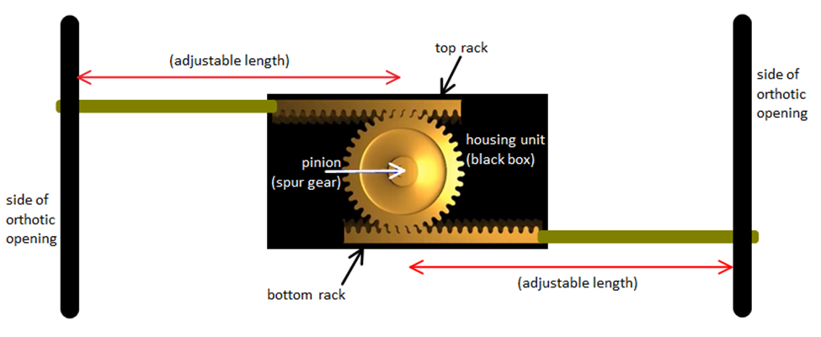
Overview of Chosen Concept
Mechanism Style: Rack and Pinion System
Further Addition: Visual Indicator System for Assessing Tightness
Notes:
primary selection was in choosing a particular style; “style” used to refer to different approaches, drawing upon imagination but upon methods of locking and fixing features together, some in strapping applications from other industries and some from entirely unrelated applications

Slide 7
Analytic Efforts

Slide 8
Assessment of Tightening Forces
How tight is “tight enough”?
pertinent to the indicator system
desired tightening force measure “stored” within springs
initial theoretical approach
compression of springs (Hooke’s Law) equating to the tension in the straps
too many unknowns
α
Normal Force
Strap Tension Forces
Notes:
evaluating the forces involved two essential considerations, the first was determining “how tight is tight enough?”

Slide 9
Assessment of Tightening Forces (cont’d)
solution: collection of empirical data and selection of specific spring geometry
spring scale with existing strap design with 21 yr old female subject
average force from repeated trials was 5.0 lb
four springs; each to be 1.25 lb
spring displacement: 0.25 in
Hooke’s Law
F = -kx … k = -F/x
k = 1.25lb /(.25in) = 5 lb/in
Notes:
springs in parallel

Slide 10
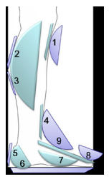
Assessment of Loading Forces
What will be peak loading?
45 lb max load – Silva et al
failure point
material deformation strengths
Silva et al.
Notes:
failure point expected to be wire rope (75 lb max loading)

Slide 11
Sizing Considerations
anthropometric data of calf circumference
minimum two sizes
data of a 5-yr old; focus on CP patients
stunted growth and atrophied muscles
orthotic opening 1/3 of calf circumference
$\left(\frac{1}{3}x 25.9cm\right)÷2.54\frac{cm}{in}=3.39in$
CP (5 years old) Children: Calf Circumference (cm)
Male |  |  | Female
10% | 50% | 90% | 10% | 50% | 90%
25.9 | 29.9 | 35.5 | 27 | 30.6 | 36.5
Data from: http://www.cdc.gov/nchs/data/nhsr/nhsr010.pdf

Slide 12
Specific Details of Chosen Design

Slide 13
Design Overview – The Big Picture
3”
1¾”
1 1/3”

Slide 14
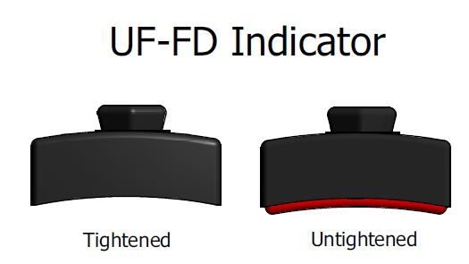
User Interface / Indicator System
Shell, Spring Base, Knob
Tightening forces spring base into shell
Push/pull of knob to lock/unlock
Notes:
Safety
Racks and straps
metal racks always contained within housing; straps only component passing through shell wall
components fixed together via screws

Slide 15
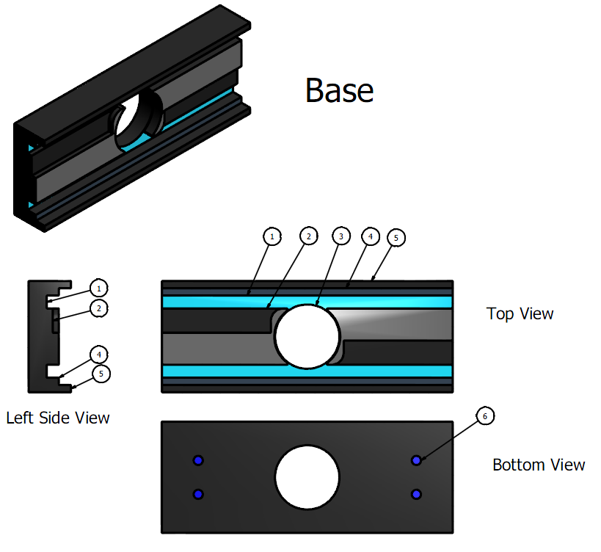
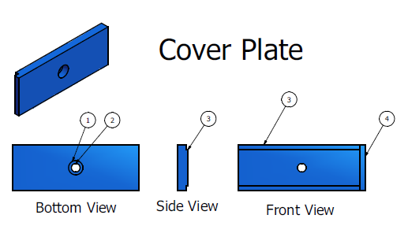
Housing Pieces
Base
Cover Plate

Slide 16
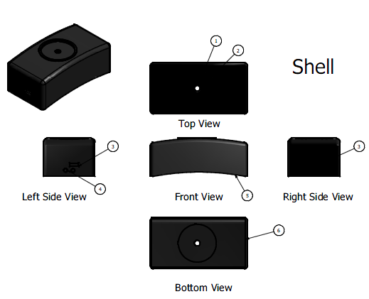
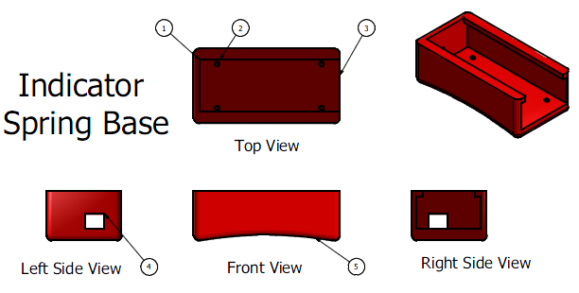
Housing Pieces (cont’d)
Shell
Indicator Spring Base
Notes:
ABS material – high mechanical and tensile strenght, medium pricing, molded/fabricated easily; electrically insulated
Delrin for prototyping

Slide 17
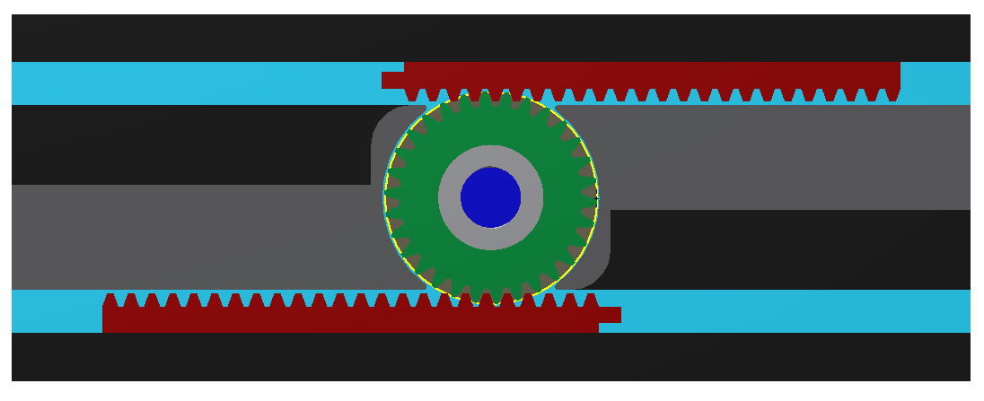
Gear Mechanism

Slide 18
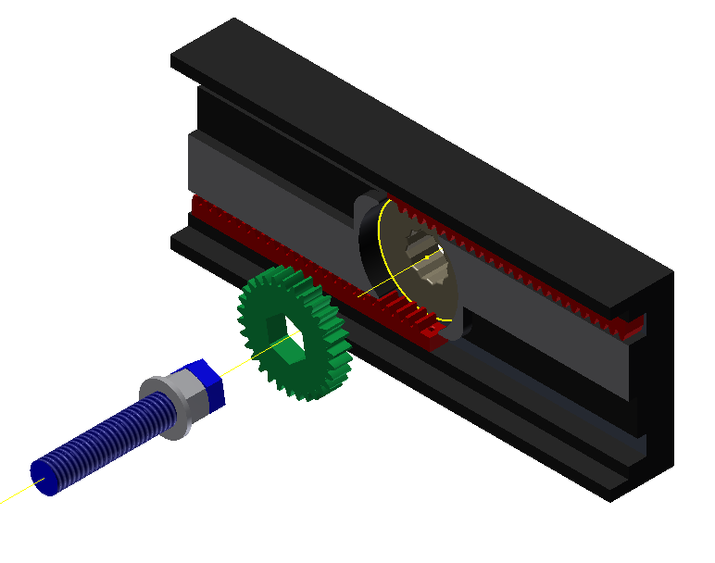
Gear Mechanism & Tightening
Notes:
Moving into the House

Slide 19
Locking the Gears

Slide 20
Locking the Gears (cont’d)
Male Lock Component
Spur Gear
Notes:
spur gear measures approx. 2/3” in max diameter

Slide 21
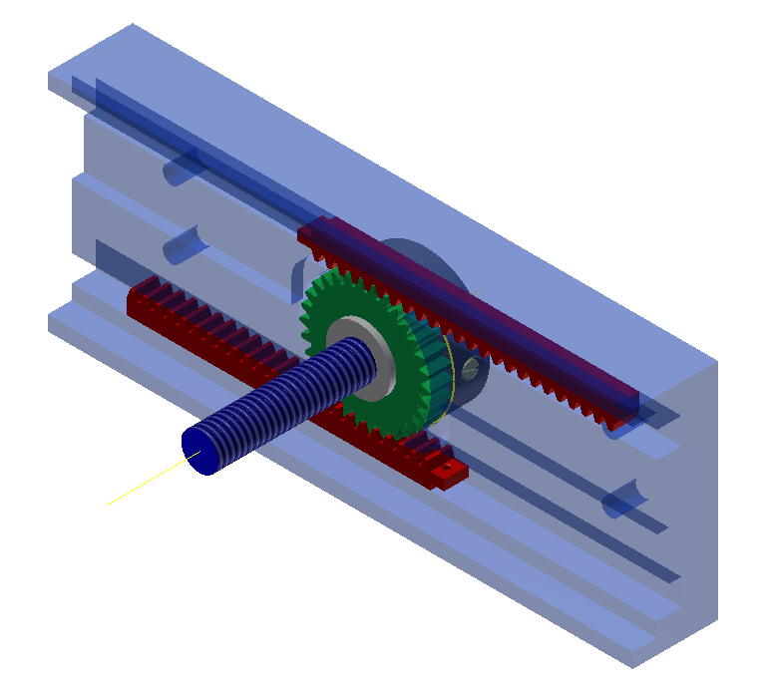
Summary of Body Components

Slide 22
Manufacture

Slide 23
Standard Parts
Ball Plunger
Flanged Nut
Springs
Straps
Rivets
Screws
Oval Sleeve
Wire Rope
1/32”
Notes:
acquisition of standard parts

Slide 24
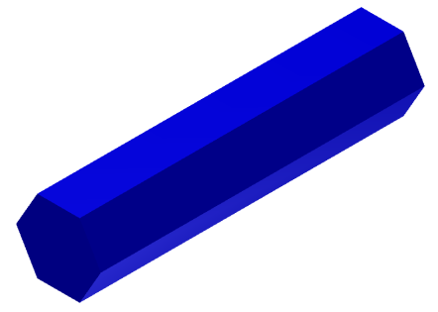
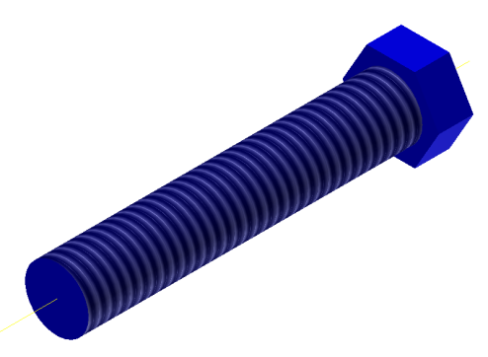
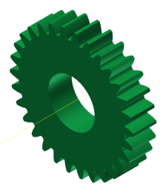
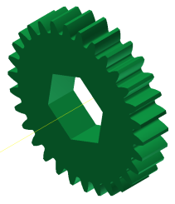
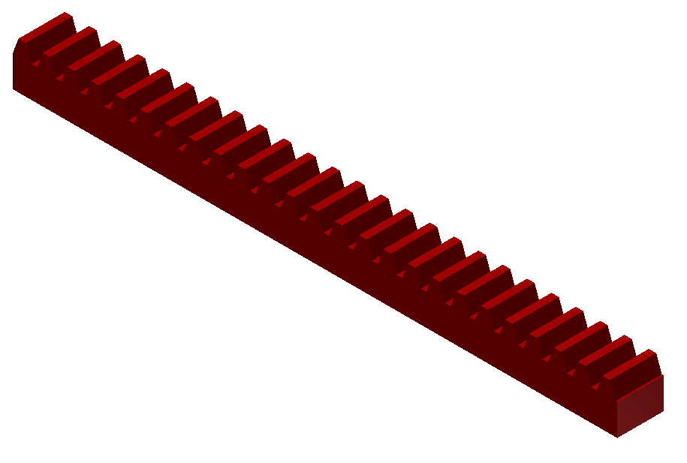
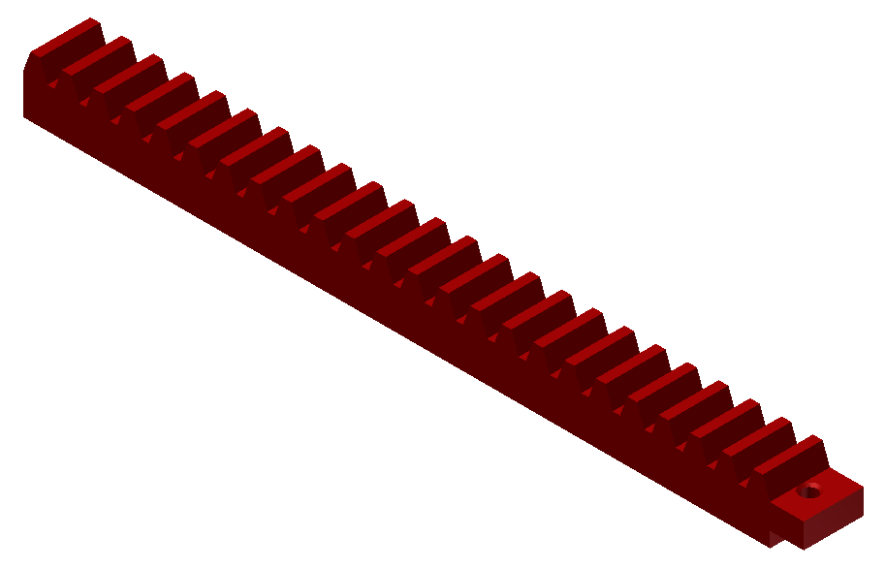
Purchased Parts w/ Modifications
Hex Stock
Spur Gear
Racks

Slide 25
Prototyping
Component | Cost (Dollars)
Body | 148
Cover Plate | 122
Knob | 60
Lock Ring | 110
Racks (x2) | 156
Shaft | 122
Spring Base | 136
Spring Shell | 136
Spur Gear | 25
Assembly | 3.25
Springs | 21.80
Locknut | 5.11
Ball Plunger | 4.23
TOTAL | $1050
Total Cost: $1050

Slide 26
Mass Production
Component | Cost (Dollars)
Body | 4.10
Cover Plate | 4.10
Knob | 7
Lock Ring | 21.80
Racks (x2) | 31.50
Shaft | 4.15
Spring Base | 15.7
Spring Shell | 14
Spur Gear | 12.15
Assembly | 3.25
Springs | 21.80
Locknut | 1.02
Ball Plunger | 4.23
TOTAL | $145
Total Cost: $145
Notes:
assembly done by TVR Machine

Slide 27
Lead Times
Prototype – 4 weeks
Molds – 12 weeks
1000 Parts – 5weeks
Notes:
5 weeks from the time order placed with TVR with all necessary materials delivered at that time as well

Slide 28
Conclusions

Slide 29
Prospective Conclusions
Further Improvements of Design
reduction in cost
thinner profile
clearer presentation of indicator system
Additional Designs
adult size
development and incorporation of distal strap
Intellectual Property Considerations
possible patents for indicator system and assembly method
undesirable increase in cost to user
Notes:
desig

Slide 30
Retrospective Conclusions
Did we solve the problem – reducing user error
Revising our Project Path
choices made in development of AFO-FD
allowing modification of actual manufacture process
incorporating more features of the orthotic
Revising our Course Path
selection of design topic
bioengineering or biotech focus
insufficient preparation for purely mechanical design
Semester Trends
compromise and balance of leadership
allowance for repeating work and addressing myriad of small details

Slide 31
Frequently Asked Questions
What is your name? – Bryce Miller
What is your group number? – 11

