Slide 1
User friendly Ankle-foot orthotic
Alessandra Hruschka, Bryce Miller, Gina Maliekal
Mentor: Kurt Thoroughman
Team 11

Slide 2
AFOs are used to correct foot deformities and/or strengthen targeted muscle groups to promote proper ambulation.
Incorrect donning of the AFO can result in a misaligned configuration between the foot and orthotic, which causes undesirable force distributions and movements.
Incorrectly worn/secured AFOs will not only deviate from intended function but can cause further harm.
In order to improve the reliability of proper orthotic use, the mechanism(s) involved in the donning (and doffing) of the device must be reduce possible sources of user error.
The fastening system is a major source for user error and a critical area in need of improvement for increasing reliability of proper donning. (This determined via field research and expert interview.)
By enhancing the fastening mechanism of an orthotic the probability of user error during donning will be reduced; this will increase the efficiency of the orthotic and ultimately improve the user’s ambulation.
Need
Flow
Chart
Notes:
1. AFO’s redistribute forces on the foot
2. Bad donning= not intended treatment
3.Bad donning=harm
4.Need to Reduce user error
5.Stap major source of error by interviews with Mike Daily and Dr. Juknis
6.Enhancing fastening system will reduce user error, thus improve intended treatment

Slide 3
Design Requirements
The design specifications are as follows:
Lightweight
mass < 35 ounces or 1kg
Easy to both don and doff
process time (for average user) < 60 seconds
Fasten with only one arm
Low maintenance
daily care duration < 60 seconds
Inconspicuous
acceptable appearance to children users below the age of 18
Low cost
cost to user < $500 for the entire AFO
Does not significantly alter the design of AFO
Durable
Notes:
1.Lightweight- additional mass is a hinderance to ambulation
2. Easy don doff- Users need to be able to easily put on and take off orthotic
3.One arm
4. Low maintenance
5. Inconspicuous
6. Low Cost
7.Doesn’t interfere with treatment
8.Durable

Slide 4
Current Design
Velcro Strap Used fastened through a D-Ring as seen on model provided

Slide 5
Design Considerations
a. Boa
b. Interlocking Body
c. Magnets
d. Eight Loop
e. Center Release Buckle
f. Carabiner
g. Chip Clip
h. Rollerblade
i. Single Tooth Slider
j. Elastic Repeat
k. Cam Buckle
l. Spur Gear

Slide 6
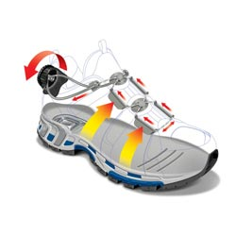
a. Boa
b. Interlocking Body
c. Magnets
d. Eight Loop
e. Center Release Buckle
f. Carabiner
g. Chip Clip
h. Rollerblade
i. Single Tooth Slider
j. Elastic Repeat
k. Cam Buckle
l. Spur Gear
Image from: http://www.backcountry.com/store/newsletter/a256/The-Boa-Revolution.html
Notes:
-Tension on interwoven cable system
-Turn of knob increases tension and tightens device

Slide 7
a. Boa
b. Interlocking Body
c. Magnets
d. Eight Loop
e. Center Release Buckle
f. Carabiner
g. Chip Clip
h. Rollerblade
i. Single Tooth Slider
j. Elastic Repeat
k. Cam Buckle
l. Spur Gear
Covers the entire orthotic opening
Interlocks in the area between the device and the user’s leg
Prevents catching

Slide 8
a. Boa
b. Interlocking Body
c. Magnets
d. Eight Loop
e. Center Release Buckle
f. Carabiner
g. Chip Clip
h. Rollerblade
i. Single Tooth Slider
j. Elastic Repeat
k. Cam Buckle
l. Spur Gear
Use of magnetic attraction to fasten the strap across the orthotic opening

Slide 9
a. Boa
b. Interlocking Body
c. Magnets
d. Eight Loop
e. Center Release Buckle
f. Carabiner
g. Chip Clip
h. Rollerblade
i. Single Tooth Slider
j. Elastic Repeat
k. Cam Buckle
l. Spur Gear
Image taken from http://www.strapworks.com/Metal_Slides_p/ms-r.htm
Notes:
Strap is looped through device and tightness is maintained once strap has been appropriatly tightened

Slide 10
a. Boa
b. Interlocking Body
c. Magnets
d. Eight Loop
e. Center Release Buckle
f. Carabiner
g. Chip Clip
h. Rollerblade
i. Single Tooth Slider
j. Elastic Repeat
k. Cam Buckle
l. Spur Gear
http://www.usalanyards.com/easy-center-release-buckle-p-051-20.aspx
Notes:
Attach the two together

Slide 11
a. Boa
b. Interlocking Body
c. Magnets
d. Eight Loop
e. Center Release Buckle
f. Carabiner
g. Chip Clip
h. Rollerblade
i. Single Tooth Slider
j. Elastic Repeat
k. Cam Buckle
l. Spur Gear
Image from
http://www.luggages-bags.com/productdetail/1000915965/sturdybackpackswivelhook.htm
Notes:
Link the strap into the carabiner

Slide 12
a. Boa
b. Interlocking Body
c. Magnets
d. Eight Loop
e. Center Release Buckle
f. Carabiner
g. Chip Clip
h. Rollerblade
i. Single Tooth Slider
j. Elastic Repeat
k. Cam Buckle
l. Spur Gear
Image from
http://www.womansday.com/Articles/Food-Recipes/Fabulous-Food-Storage-Products.html

Slide 13
a. Boa
b. Interlocking Body
c. Magnets
d. Eight Loop
e. Center Release Buckle
f. Carabiner
g. Chip Clip
h. Rollerblade
i. Single Tooth Slider
j. Elastic Repeat
k. Cam Buckle
l. Spur Gear
Image taken from
http://www.clic-n-roll.com/rollerblade-trs-buckle-x1-rollerblade,us,4,00953300.cfm

Slide 14
a. Boa
b. Interlocking Body
c. Magnets
d. Eight Loop
e. Center Release Buckle
f. Carabiner
g. Chip Clip
h. Rollerblade
i. Single Tooth Slider
j. Elastic Repeat
k. Cam Buckle
l. Spur Gear
Image taken from: http://www.beltbarriers.com/activacioncart-producto.asp?ProductoID=5&CategoriaID=1&SubCategoriaID=24

Slide 15
a. Boa
b. Interlocking Body
c. Magnets
d. Eight Loop
e. Center Release Buckle
f. Carabiner
g. Chip Clip
h. Rollerblade
i. Single Tooth Slider
j. Elastic Repeat
k. Cam Buckle
l. Spur Gear
Series of elastic bands permanently fixed onto both sides of the orthotic
Foot slid into AFO

Slide 16
a. Boa
b. Interlocking Body
c. Magnets
d. Eight Loop
e. Center Release Buckle
f. Carabiner
g. Chip Clip
h. Rollerblade
i. Single Tooth Slider
j. Elastic Repeat
k. Cam Buckle
l. Spur Gear
Image from http://www.usalanyards.com/ZoomImage.aspx?productID=e1e68ba8-4475-4337-8110-5da7ec2c6f62

Slide 17
a. Boa
b. Interlocking Body
c. Magnets
d. Eight Loop
e. Center Release Buckle
f. Carabiner
g. Chip Clip
h. Rollerblade
i. Single Tooth Slider
j. Elastic Repeat
k. Cam Buckle
l. Spur Gear
Enclosed mechanism utilizing a spur gear for strap tightness adjustment

Slide 18
Stage 1: Qualitative Elimination
Boa
Knob to increase tension in cords was patented.
Unable to develop a unique and independent design
Interlocking Body
Alteration of manufacturing procedure would need to be done.
Design would not be easily implemented.
Magnets
Strength of the magnets is questionable
Possibility of accidental slip would need to be maintained for the fastening method.
Eight Loop
Too complicated to maneuver with one hand.
Elastic Bands
Would not be accommodating to a deformed foot.
Plastic deformation and failure of strap during ambulation is possible
Notes:
Boa: Would not be able to have a unique and independent design

Slide 19
Stage 2: Primary Pugh Analysis

Slide 20
Primary Pugh Analysis: Ease of Use
Notes:
1.Movable Parts during fastening
2.Number of steps to don
3.Steps to doff
4.Low profile

Slide 21
Primary Pugh Analysis: Safety
Notes:
1. Risk of Device Attaching to surroundings
2. Risk of accidental injury (pinching)

Slide 22
Primary Pugh Analysis: Consistent AFO Function
Notes:
Ability to withstand daily ambulation
-likelyhood of failure during use
Extra weight= hinderance
-Design have an adjustability in tightness

Slide 23
Stage 2: Primary Pugh Analysis

Slide 24
Eliminated from Consideration
Carabiner: -24
Chip Clip: -33
CAM: 2

Slide 25
Stage 3: Further Pugh Analysis

Slide 26
Complete Pugh Analysis

Slide 27
Spur Gear
Selected Design

Slide 28
Details of Selected Design
Spur Gear and Saw Thread
The Locking Mechanism
Housing Unit
User’s Involvement
Notes:
4 Major Regions

Slide 29
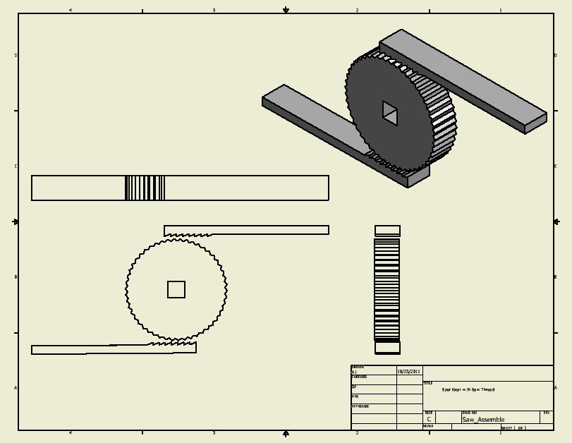
Spur Gear and Saw Thread
The Locking Mechanism
Housing Unit
User’s Involvement
Notes:
Spur Gear
-Two Saw Threads

Slide 30
Spur Gear and Saw Thread
The Locking Mechanism
Housing Unit
User’s Involvement
Two Main Areas of Consideration
Saw Thread Lock
Spur Gear Lock
Notes:
-Saw Thread
-Spur Gear Lock

Slide 31
Saw Thread Lock: Prevent Slip
Notes:
-Prevent saw threads from
-slipping
- unwanted movement

Slide 32
Spur Gear Lock: Lock Adjustment
Notes:
-Adjust tightness of strap by moving gear
-Part is extruded outside of housing for user interaction

Slide 33
Spur Gear and Saw Thread
The Locking Mechanism
Housing Unit
User’s Involvement
Device needs to be housed to:
1. Prevent user interference
2. Protect user from
accidental injury

Slide 34
Spur Gear and Saw Thread
The Locking Mechanism
Housing Unit
User’s Involvement
All user will need to do is
pull the spur gear adjustment knob
up or down to lock/unlock device
and twist to tighten or loosen straps

Slide 35
Team Responsibilities
Alessandra Hruschka | Gina Maliekal | Bryce Miller | Shared
-Progress Report Presenter -AutoCAD Designer -Biomechanics Researcher | -Preliminary Report Presenter -Organizer -Mentor Contact -Website Designer -China Field Research Point Person | -Final Reporter Presenter -Editor -St. Louis Field Research Person | -Concept Generation and Research -Weekly Reports -Main Reports

Slide 36
Team Schedule
Notes:
Based on class sylabus

Slide 37
Special Thanks To:
Dr. Juknis, Associate Professor of Neurology at Washington University School of Medicine in St. Louis
Michael Dailey from Orthotic & Prosthetic Design
Jerry Craig from Washington University in St.Louis Engineering School

Slide 38
Questions?
Name: Alessandra (Ali) Hruschka
Group: 11

